Slide 1
Assignment 3
Exploratory Data Analysis
Genna, Yichen, Perpetua, Michelle

Slide 2
1: Initial Hypotheses

Slide 3
Motivation
Hypotheses
We happened to be an all-women team who also all enjoy watching movies, so we thought we could use data to explore an important issue in movies: female representation. As the standard test used in the industry to measure this, the Bechdel test was the obvious choice to analyze. With the outsized influence of movies on mainstream culture, we thought it would be especially important to investigate the social implications of the Bechdel test and how positive female representation can be either helped or hindered by economic factors like box office revenue and budget considerations.
Are movies getting better at passing the Bechdel test?
Why do movies fail the Bechdel test, and has that changed?
Are movies that pass the Bechdel test becoming more “mainstream”?
Does the size of a movie’s budget predict if it will pass?
Does passing the Bechdel test affect a movie’s profitability?

Slide 4
Analysis Plan
First, we plan on cleaning the dataset and preprocessing it to ensure there are no missing or incorrect values, as well as calculating custom metrics that would be helpful in answering the hypotheses such as profit and pass rates. Then, we will explore trends in the data as well as the shape of it using Tableau to determine the best way to visualize answers to our hypotheses. The hypotheses related to changes over time can be investigated by visualizing the variable of interest over time, and the other hypotheses related to the connection between two variables can be investigated by visualizations that directly compare the two.

Slide 5
2: Data Source

Slide 6
Data Source
Description: The dataset contains 1,794 films released between 1970 and 2013. It tracks the Bechdel Test "Binary" result (Pass/Fail) alongside critical financial metrics: Production Budget, Domestic Gross, and International Gross. We specifically utilized the 2013-inflation-adjusted columns to ensure that financial comparisons across four decades were normalized and accurate.
Source: The data was sourced from the FiveThirtyEight GitHub repository, originally compiled for the report "The Dollar-And-Cents Case Against Hollywood's Exclusion of Women." The researchers merged crowdsourced test results from BechdelTest.com with professional financial tracking data from The Numbers (Nash Information Services).
Format: The original data was a structured CSV file. This allowed for a clean import into Tableau, with each row representing a unique film and its corresponding financial and gender-representation metrics.
Transformations: To prepare the data for accurate analysis, we performed four essential transformations. We first implemented Inflation Normalization by prioritizing 2013-adjusted dollars, ensuring financial comparisons across four decades remained consistent. We then applied Binary Simplification to group complex failure codes into a streamlined "Pass/Fail" dimension and executed an Aggregation Shift from "Sum" to "Average" to capture the typical film's budget rather than misleading yearly totals.

Slide 7
3: Exploration

Slide 8
Hypotheses
Are movies getting better at passing the Bechdel test?
Why do movies fail the Bechdel test, and has that changed?
Are movies that pass the Bechdel test becoming more “mainstream”?
Does the size of a movie’s budget predict if it will pass?
Does passing the Bechdel test affect a movie’s profitability?

Slide 9
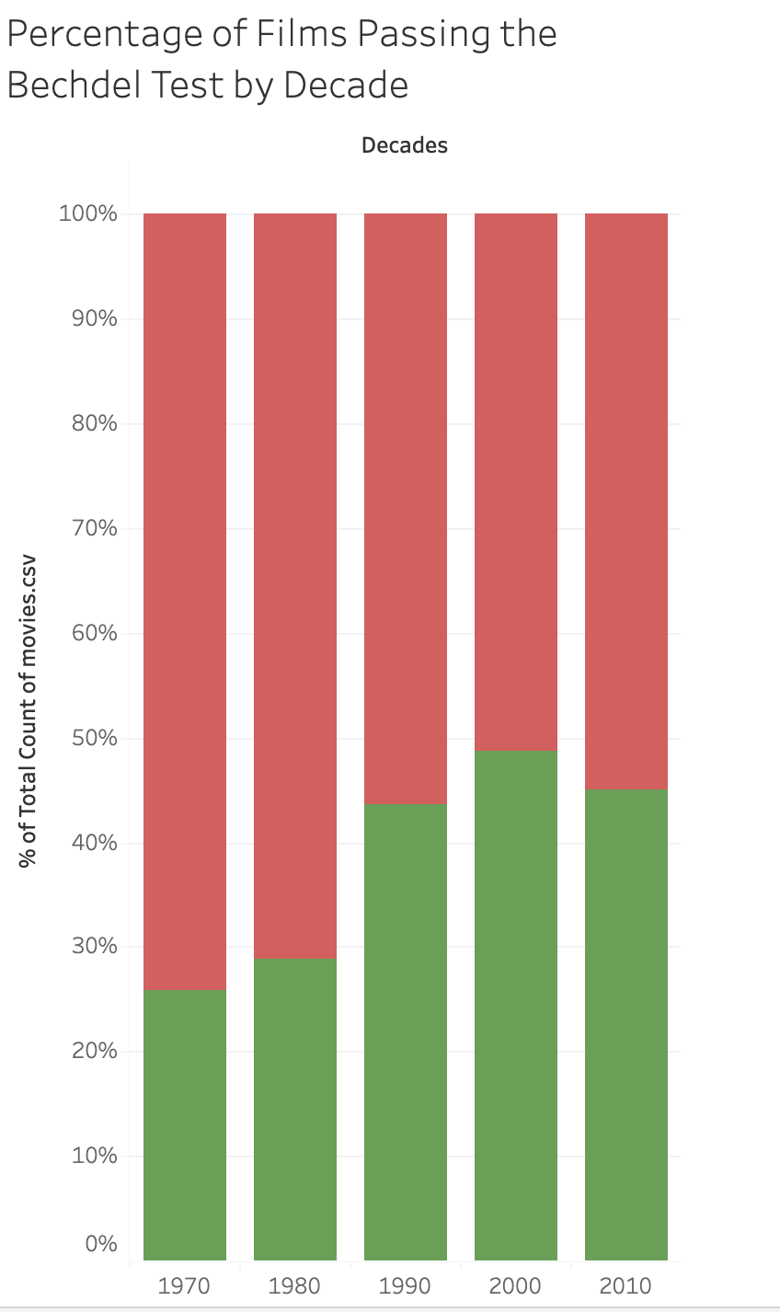

How has the percentage of films passing the Bechdel Test changed across decades?
This visualization shows the percentage of films passing the Bechdel Test across decades. The percentage of passing films increases steadily from the 1970s through the 2000s, nearly doubling over that period. While the 2010s show a slight decline, it overall remains significantly higher than earlier decades.

Slide 10
Hypotheses
Are movies getting better at passing the Bechdel test?
Why do movies fail the Bechdel test, and has that changed?
Are movies that pass the Bechdel test becoming more “mainstream”?
Does the size of a movie’s budget predict if it will pass?
Does passing the Bechdel test affect a movie’s profitability?

Slide 11
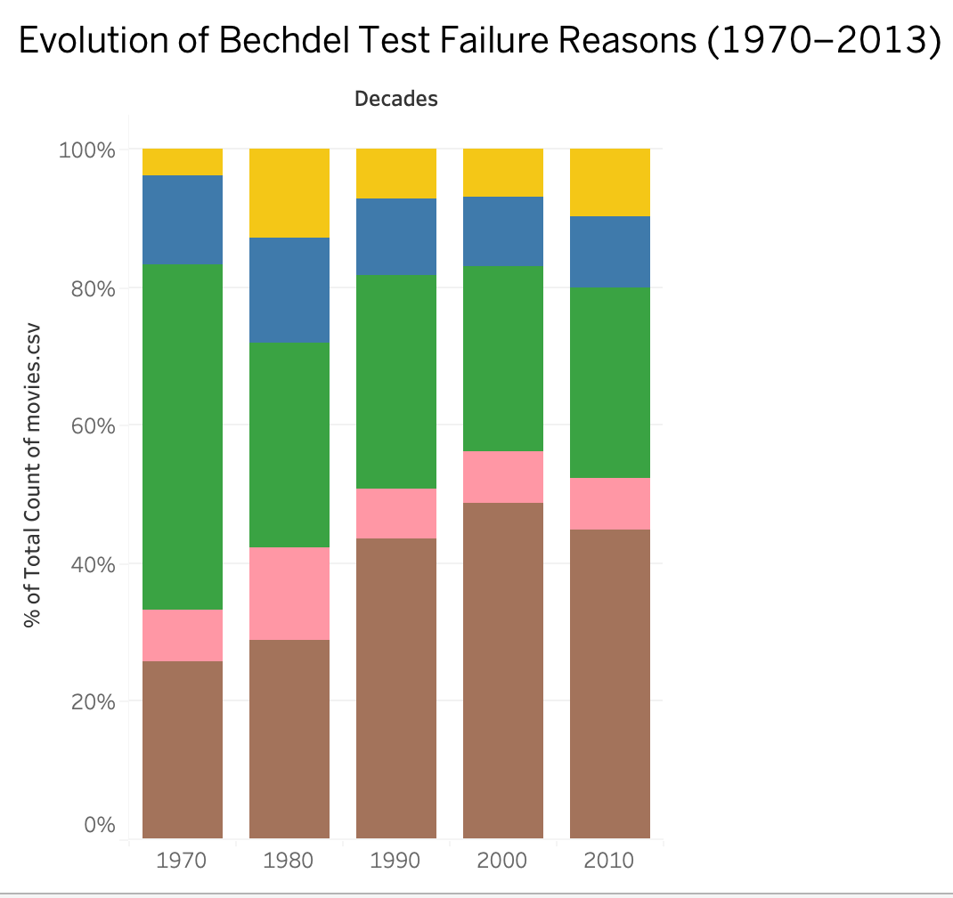

Why do movies fail the Bechdel test, and has that changed?
This chart reveals that while the percentage of movies passing the test ("ok") has nearly doubled since the 1970s, the most persistent reason for failure is "notalk": women characters not speaking to each other about anything besides a man. Additionally, the "nowomen" category (no two named women in the film) has seen a steady decline, indicating an improvement in female presence, even if dialogue remains a hurdle.

Slide 12
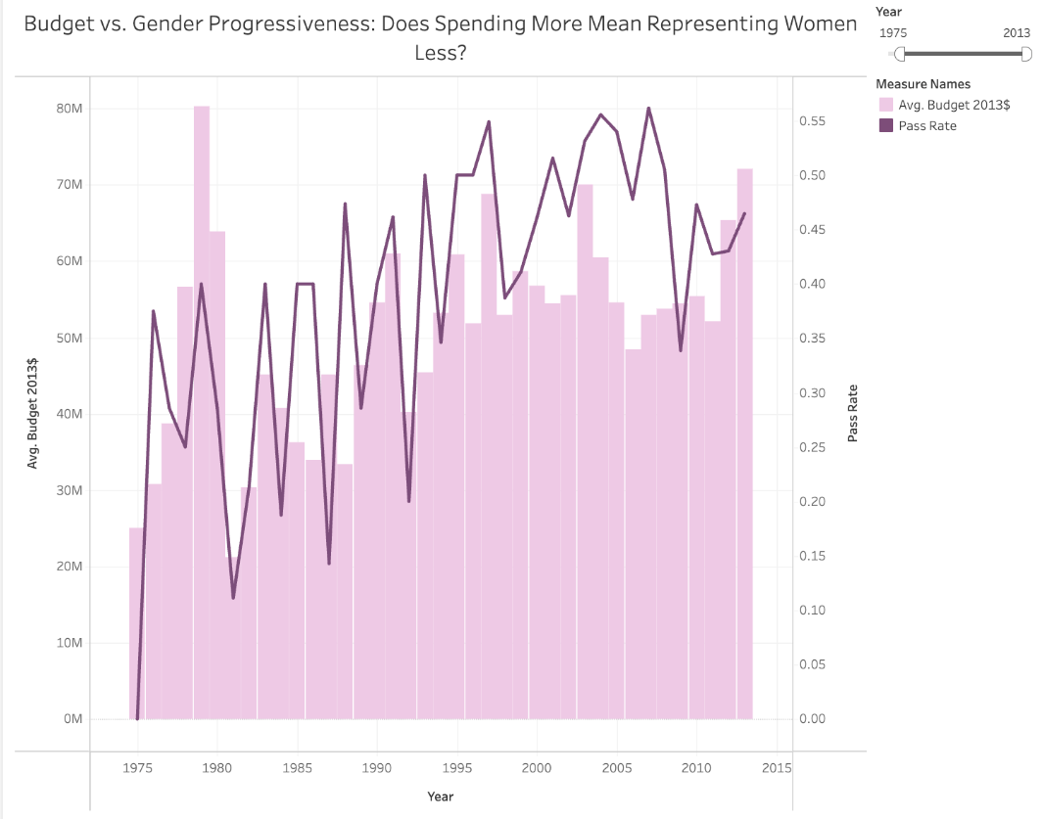
Does Spending More Mean Representing Women Less?
Calculations:
Pass Flag = If[Binary]="PASS" THEN 1 ELSE 0 END
Pass Rate = SUM([Pass Flag]) / COUNT([Binary])
Budget and pass rate move largely independently across the dataset. Some of the lowest pass rate years coincide with low budgets in the mid-1970s, while the post-2000 period shows both rising budgets and improving pass rates simultaneously. This suggests no simple relationship between how much Hollywood spends and how well women are represented on screen.
Data Quality: Movies with missing or zero budget values were retained, which may cause some yearly averages to be pulled downward so a cleaned dataset would likely show an even steeper budget growth curve. Pass rate volatility in the early years (pre-1975) reflects a small sample size per year rather than genuine year-to-year swings in industry behavior, so I reduced the range to start in 1975 to avoid such biases.

Slide 13
Hypotheses
Are movies getting better at passing the Bechdel test?
Why do movies fail the Bechdel test, and has that changed?
Are movies that pass the Bechdel test becoming more “mainstream”?
Does the size of a movie’s budget predict if it will pass?
Does passing the Bechdel test affect a movie’s profitability?

Slide 14
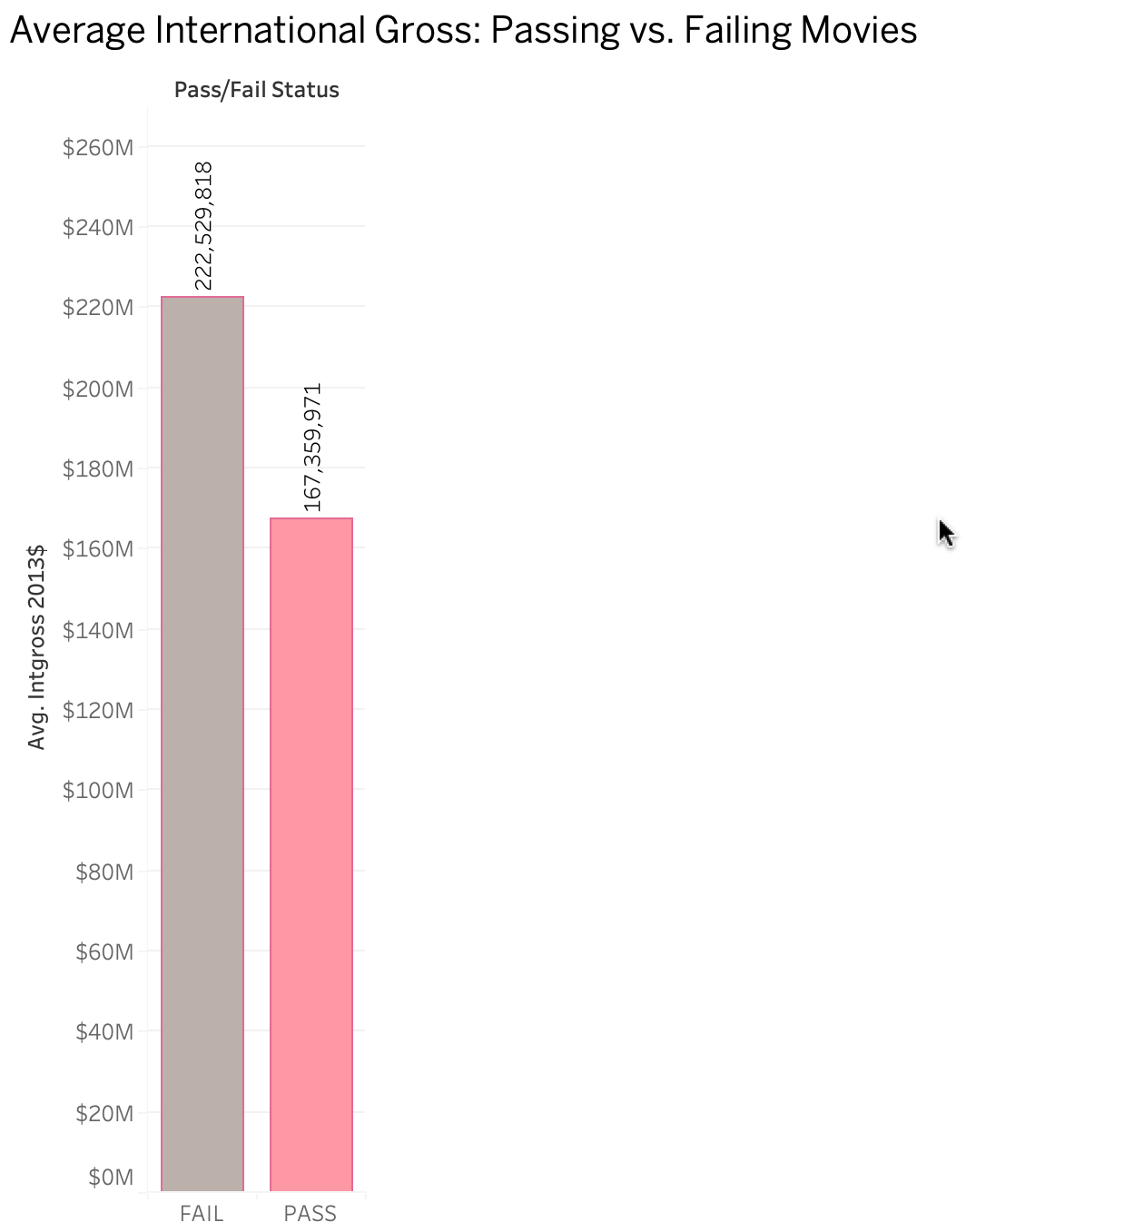

Do "passing" movies have more global appeal than "failing" ones?
On average, movies that fail the Bechdel test earn $222 million internationally, which is approximately $55 million more than movies that pass ($167 million). This data suggests that the highest-earning global "blockbusters" are still predominantly centered on male-driven narratives, creating a financial incentive for studios to continue producing films that do not prioritize gender-balanced dialogue.

Slide 15
Hypotheses
Are movies getting better at passing the Bechdel test?
Why do movies fail the Bechdel test, and has that changed?
Are movies that pass the Bechdel test becoming more “mainstream”?
Does the size of a movie’s budget predict if it will pass?
Does passing the Bechdel test affect a movie’s profitability?

Slide 16
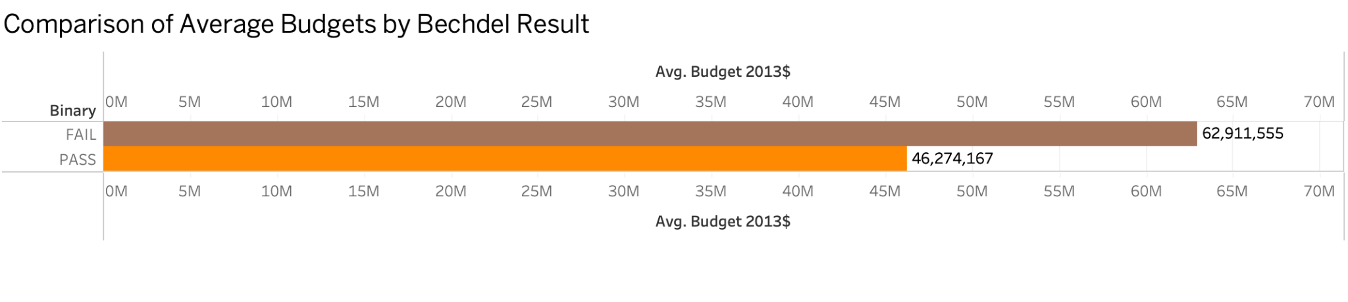

Does the size of a movie's budget predict if it will pass?
There is a clear "budget gap" where movies that fail the Bechdel test receive an average of $17 million more in funding than movies that pass. This data indicates that the highest-budget projects in Hollywood are less likely to prioritize gender-balanced storytelling or meet the basic requirements of the Bechdel test.

Slide 17
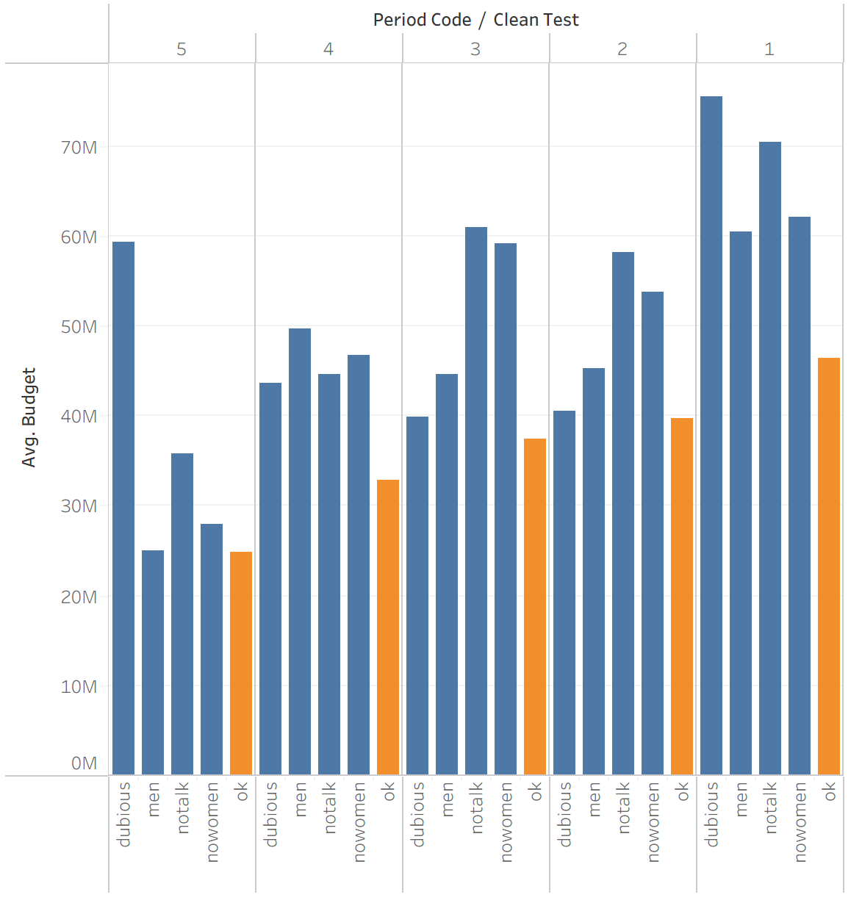

Average Budget of Different Categories of Movies Over Time
How has the budget for movies that fail different criteria of the Bechdel test changed over time?
In general, movie budgets have increased over time, but this increase in budgets is not spread uniformly across movies that pass the Bechdel test and movies that fail different criteria of the test. Budgets for movies that pass the Bechdel test have increased steadily, while budgets for movies that fail the Bechdel test have fluctuated over time.

Slide 18
Hypotheses
Are movies getting better at passing the Bechdel test?
Why do movies fail the Bechdel test, and has that changed?
Are movies that pass the Bechdel test becoming more “mainstream”?
Does the size of a movie’s budget predict if it will pass?
Does passing the Bechdel test affect a movie’s profitability?

Slide 19
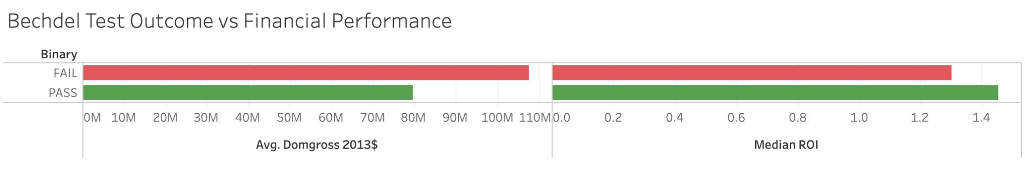
How does financial performance differ between films that pass vs fail the Bechdel Test?
Although films that fail the Bechdel Test earn higher average domestic gross revenue, Bechdel-passing films have a higher median ROI. This suggests that films that pass the test generate stronger profit returns overall.

Slide 20
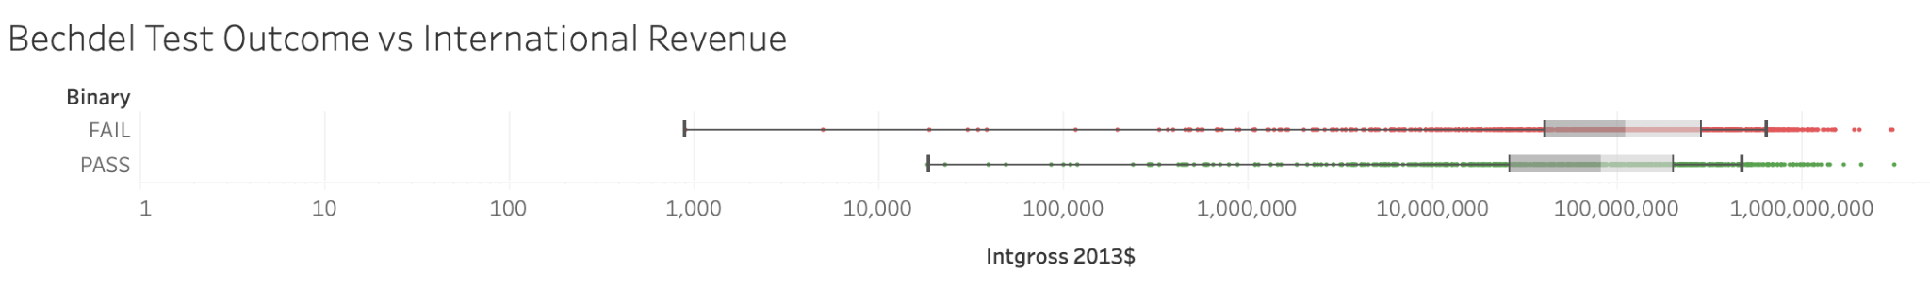
Do Bechdel-passing films make less international revenue?
Not a substantial amount. While films that fail the test have slightly more high grossing international blockbusters, the overall distribution of international revenue overlaps significantly between the groups.

Slide 21
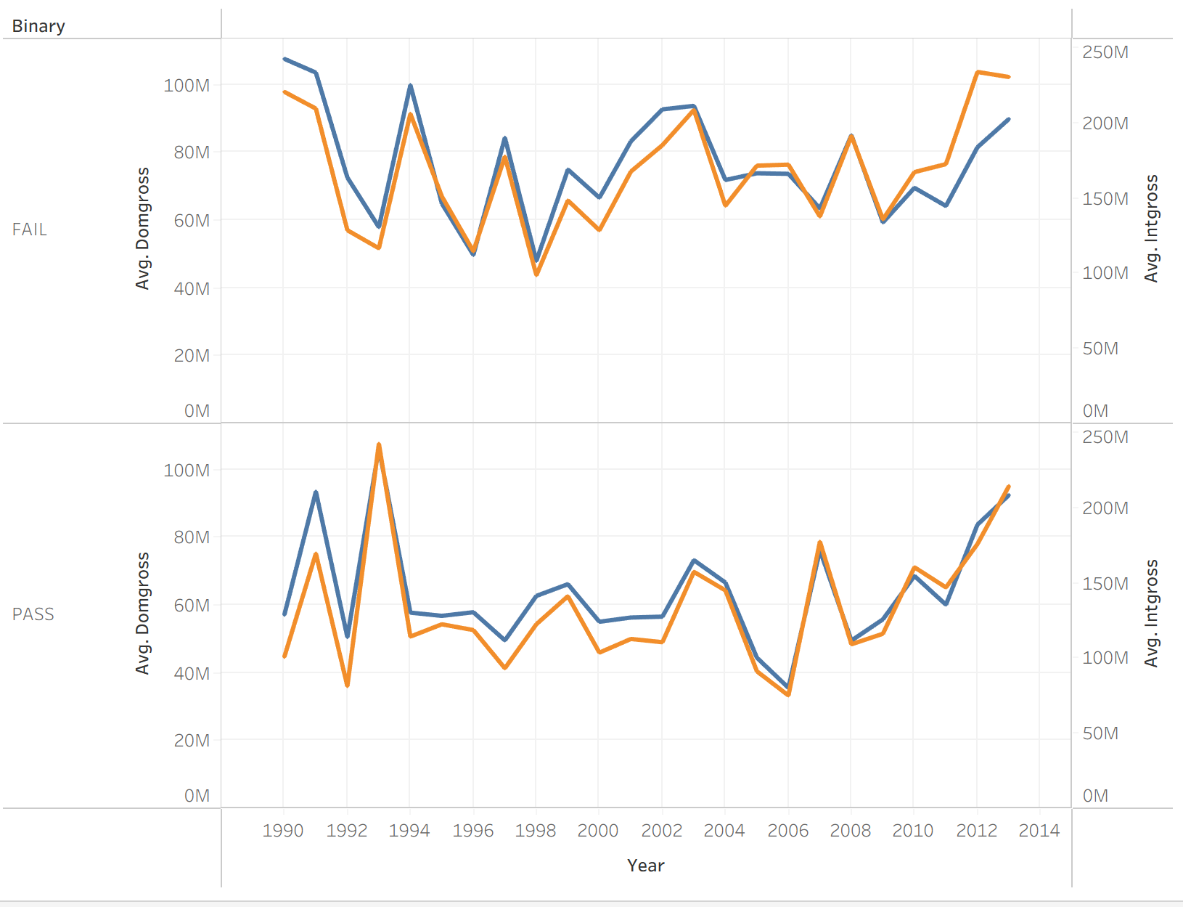
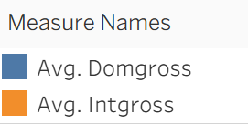
International and Domestic Box Office Revenue Over Time
How has passing the Bechdel test affected domestic and international box office revenue over time?
Over time, box office revenue has generally stayed consistent between domestic and international audiences. Although movies that fail the Bechdel test generally have higher box office revenue, in more recent years, movies that pass the Bechdel test have been earning increasingly greater box office revenue.

Slide 22
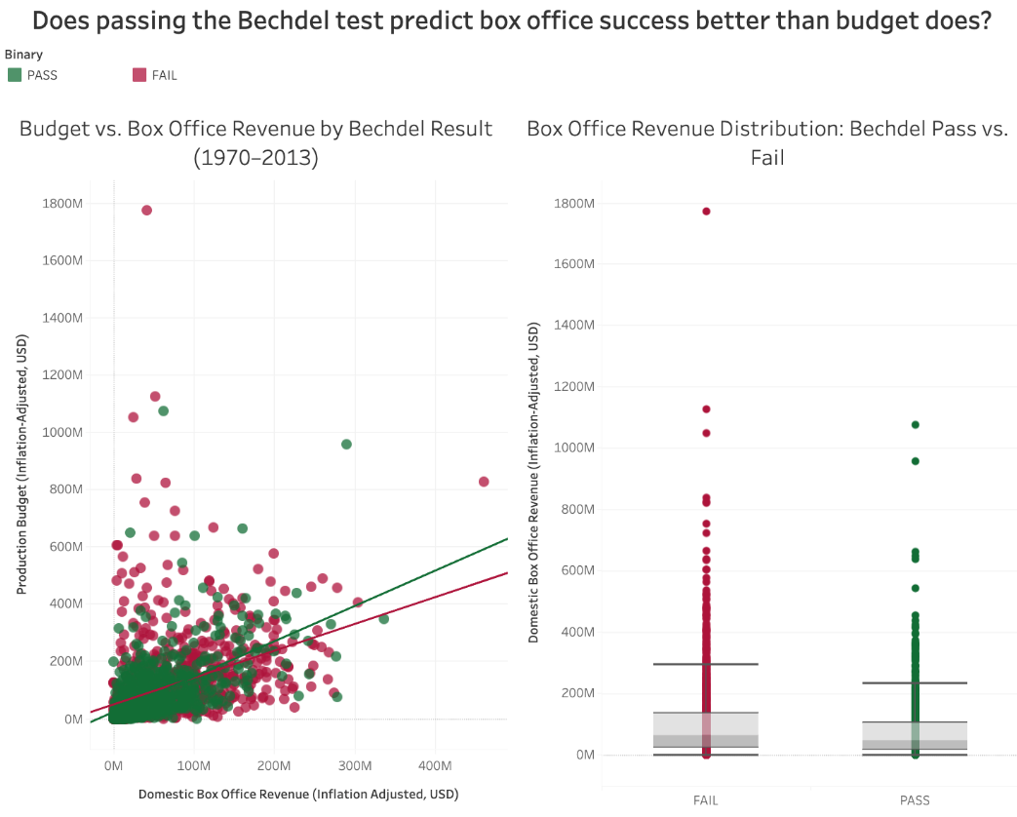
Does passing the Bechdel test predict box office success better than budget does?
Budget is the dominant predictor of box office revenue. Both PASS and FAIL films show a strong positive relationship between production budget and domestic gross, with nearly identical medians. However, PASS films trend slightly higher in returns per dollar at mid-range budgets, suggesting the Bechdel Test is not a financial liability despite FAIL films capturing the biggest outlier hits.
Data Quality: The dataset contains films where budget_2013$ or domgross_2013$ equals zero or is missing,probably due to unreported financials rather than truly zero-cost productions. I didn't remove them for the current analysis but they may compress the trend lines toward the origin and understate average returns. There's also a small number of extreme outliers in domestic gross (films earning above $800M) that can disproportionately influence the FAIL group's trend line and upper whisker.

Slide 23
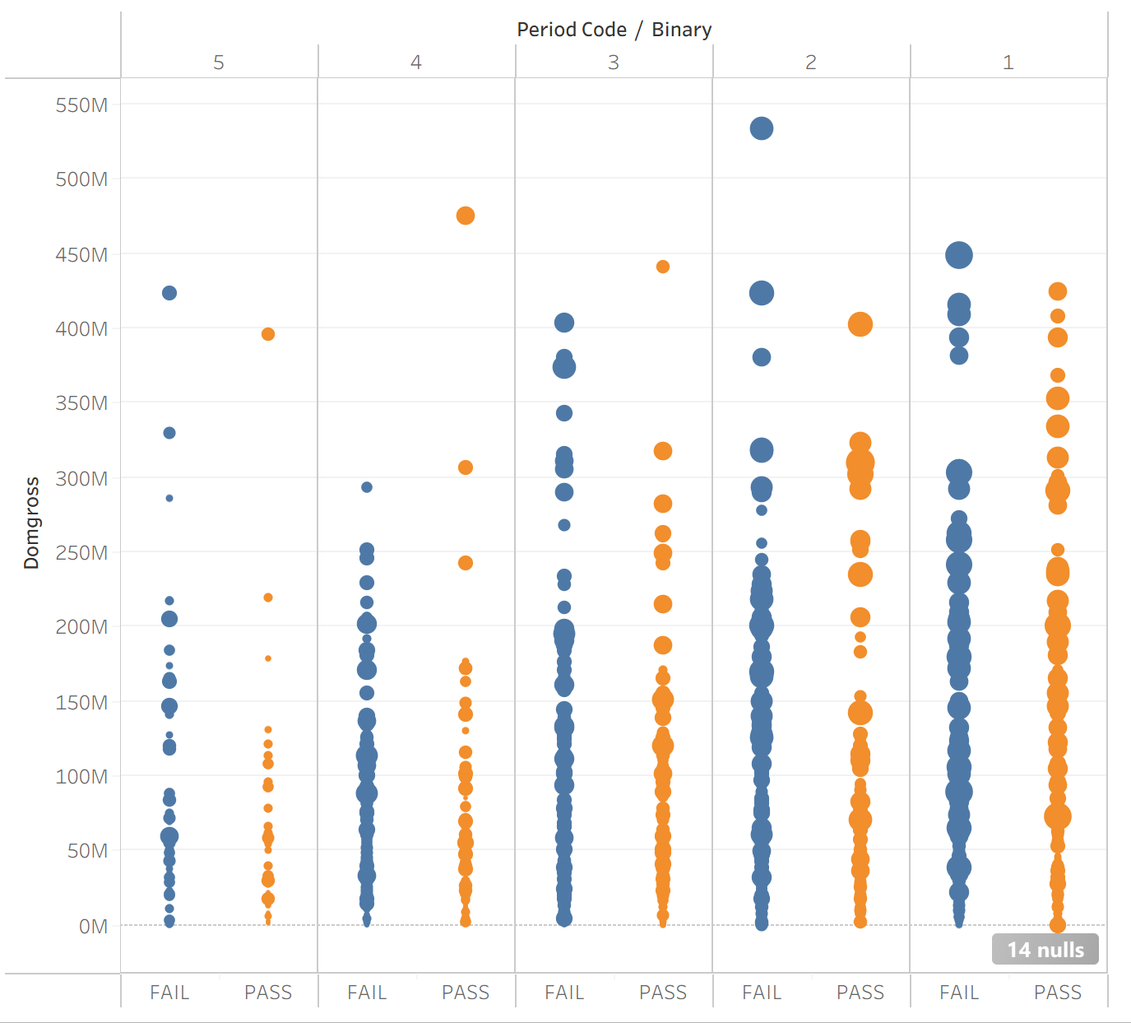
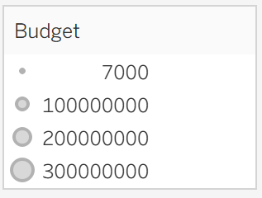
Domestic Box Office Revenue of Movies with Different Budgets Over Time
How has budget and passing the Bechdel test affected domestic box office revenue over time?
This chart shows several trends: budget and box office revenue have increased over time across all movies, but at a greater rate for movies that pass the Bechdel test. Box office revenues for the majority of “passing” movies still remain significantly lower (up to $100M) than that for movies that fail the test.

Slide 24
4: Summary Visualization

Slide 25
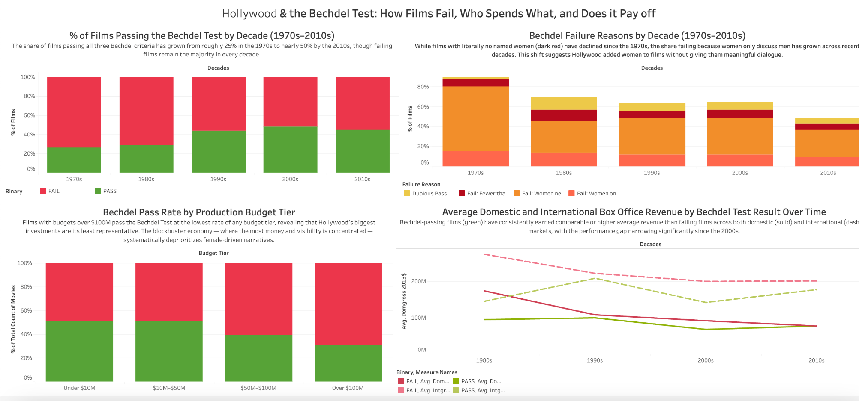
Live summary link: https://us-east-1.online.tableau.com/t/gsg2141-934b90c4d5/views/deliverable/Dashboard12/f955bc98-4a8f-4847-8b6a-88275c132280/b39eb684-74fe-4ab9-9584-8584a9a6f81a

Slide 26
Overview:
Our dashboard tracks Hollywood's gender representation through the Bechdel Test, examining whether pass rates are improving, how failure modes have evolved, whether budget predicts passing, and whether representation affects box office revenue.

Slide 27
Surprises:
The most surprising finding from Chart 3 is that bigger budgets correlate with worse representation which is the opposite of what you might expect from well-resourced studios. The blockbuster formula itself appears to be the structural driver of underrepresentation.

Slide 28
Data considerations:
Missing budget data was significant because many films especially older and smaller ones had no budget recorded, which biased Chart 3 toward larger productions. Inflation adjustment required methodological choices that affect cross-decade comparisons. The "dubious pass" category visible in Chart 2 also reflects genuine community disagreement about borderline cases, adding noise to pass/fail counts. International box office data is incomplete pre-2000, making the left side of Chart 4's lines less reliable than the right.

Slide 29
5: Conclusion

Slide 30
Our exploration began with the hypothesis that gender representation would naturally improve over time, but our analysis revealed a more complex “High-Budget Paradox”. While we initially found that the number of “Passes” is increasing, our intermediate findings showed that this progress is uneven; movies are earning more domestically, yet they still face a significant “International Gap” in revenue.
Furthermore, we discovered that the “Blockbuster Formula” itself is a major structural barrier, as studios consistently reserve their largest budgets for male-centric narratives that fail the test.
We ultimately concluded that passing the Bechdel Test does not hurt a movie’s profitability; rather, the primary hurdle is a budget gap where studios continue to bet more money on stories that fail the test, despite the proven success of representative films.

